Slide 1
Present Continuous
What are they doing?

Slide 2
Present Continuous

Slide 3
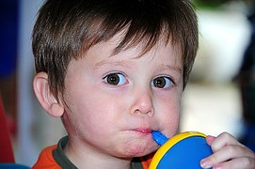
Present Continuous

Slide 4
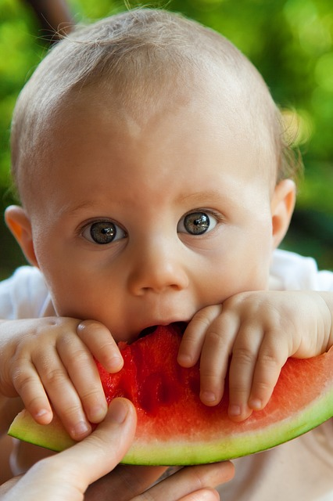
Present Continuous

Slide 5
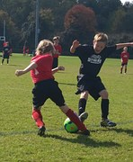
Present Continuous

Slide 6
Present Continuous

Slide 7
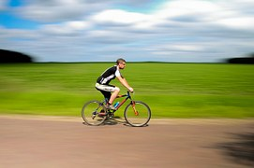
Present Continuous

Slide 8
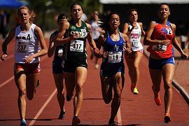
Present Continuous

Slide 9
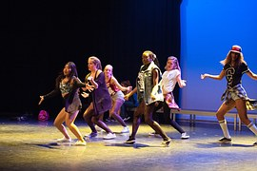
Present Continuous

Slide 10
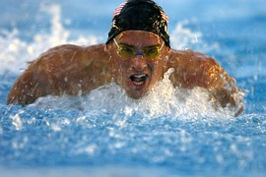
Present Continuous

Slide 11
Autor Justyna Krawczyk
Prezentacja przygotowana na potrzeby programu „Myślę – działam – idę w świat”

